Slide 1
Introduction to pencil grasps
This presentation will help staff:
Understand the different pencil grasps you might see in typically developing learners
Learn about different pencil grasps
Strategies to support those who are having difficulties with their pencil grasp.

Slide 2
About to Pencil Grasps
Children go through various stages of development in terms of their pencil grasp before they learn to use a correct pencil grasp.

Slide 3
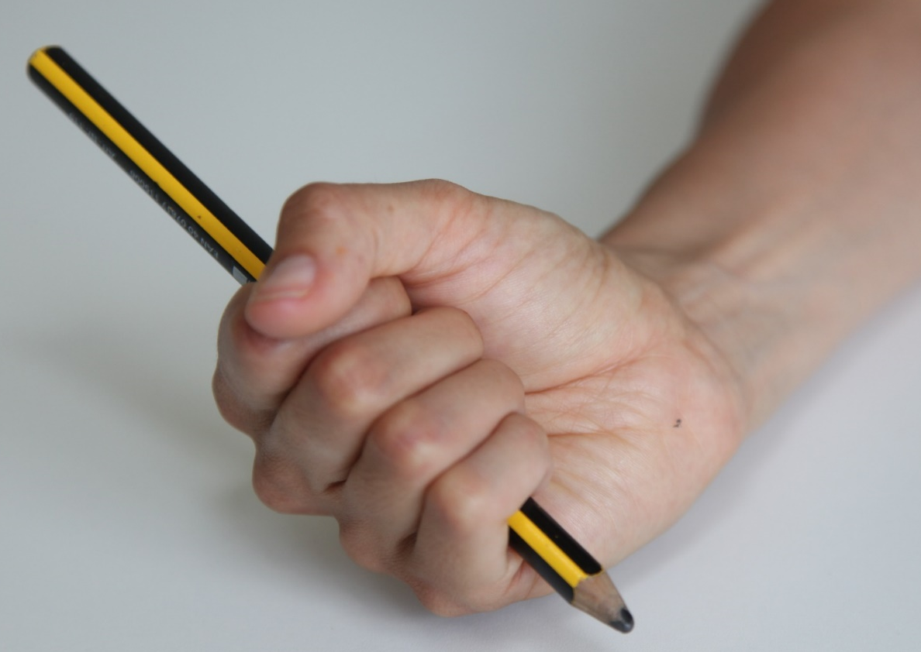
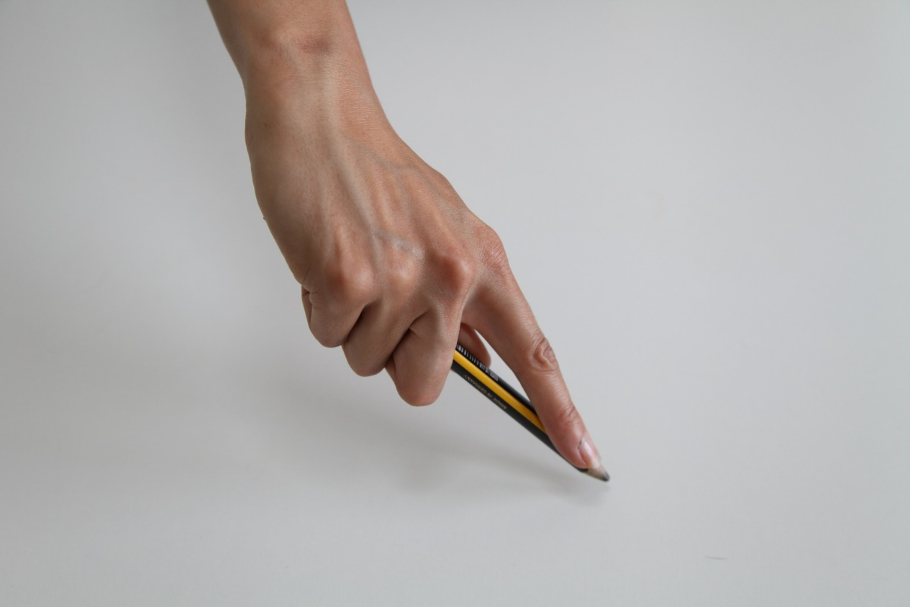
Introduction to pencil grasps
Cylindrical grasp – 12-18 months
Digital grasp- 2-3 years

Slide 4
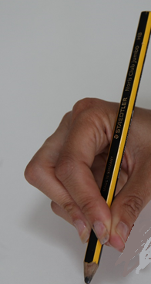
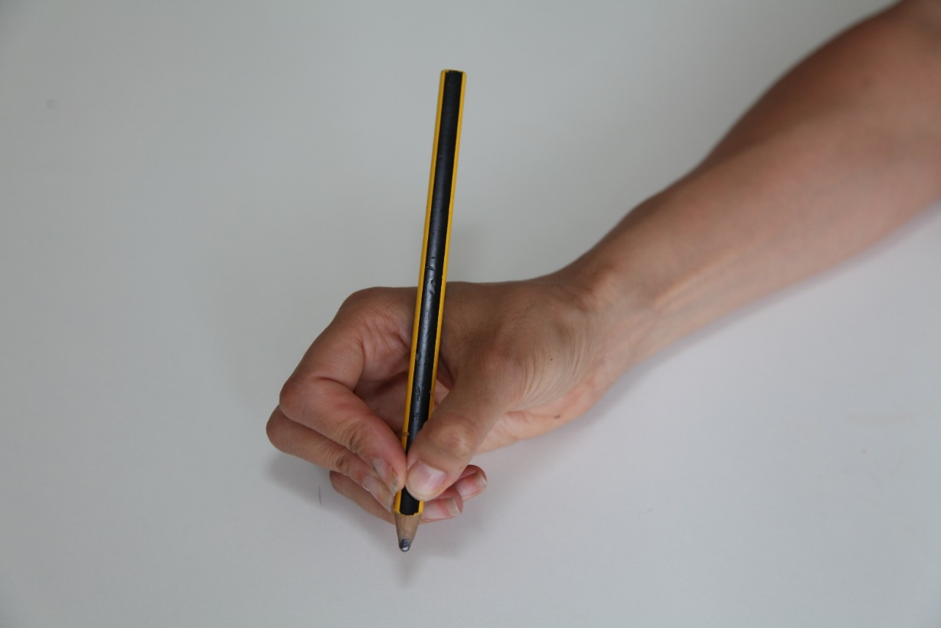
Introduction to pencil grasps
Modified tripod grip 3.5 - 4 years
4.5 - 7 years – tripod grasp

Slide 5
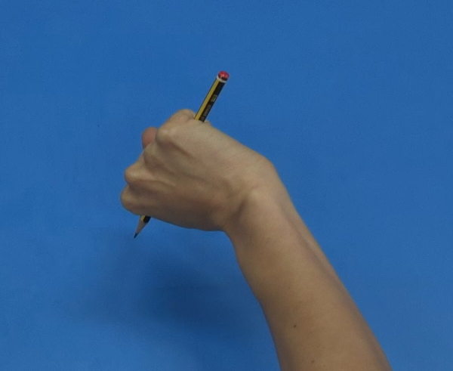
Incorrect pencil grasps
Many use a fisted grasp and this is fine for younger students, but not suitable in the long term.

Slide 6
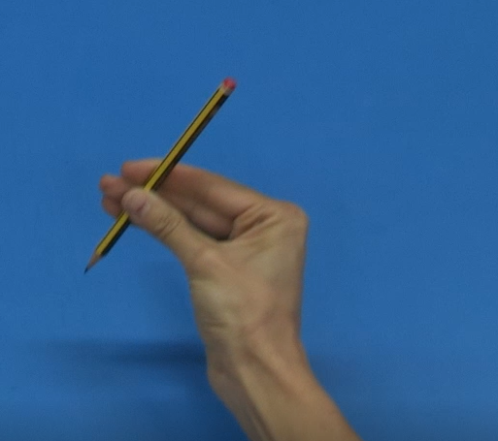
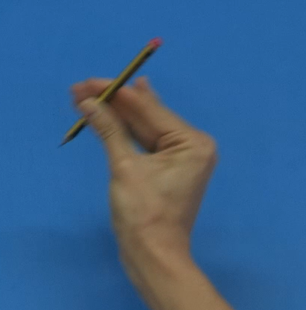
Incorrect pencil grasps
Many use 3 or 4 fingered grasps which require whole arm movements and do not help with dexterity.

Slide 7
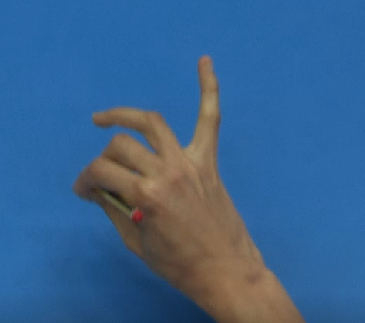
Incorrect pencil grasps
Many use tripod grasps with the ring and little finger sticking out.
This can be due to weak hands.
To remedy, place something in the hand for the little and ring finger to hold against the palm e.g. a small rubber.

Slide 8
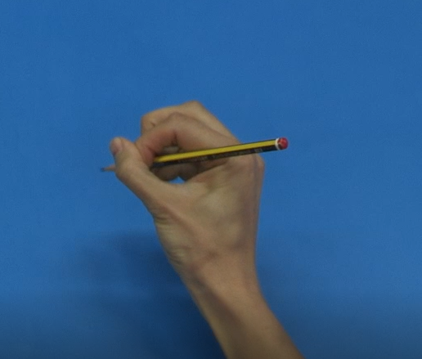
Incorrect pencil grasps
Some use a tripod grip with the thumb hooked over the index finger.
This can cause the individual to use too much pressure which can lead to hand pain.

Slide 9
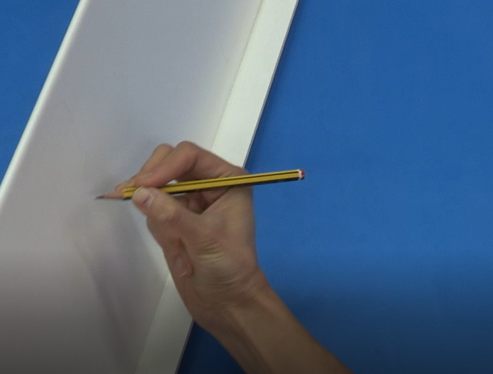
Activities to help
Use activities on angled surface to promote wrist extension.
Fingers naturally fall into tripod grasp for this.

Slide 10
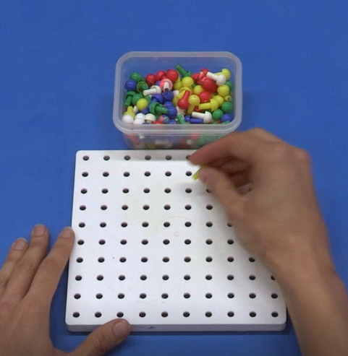
Activities to help
Use peg boards to help pincer grip, manual dexterity and bilateral skills

Slide 11
Activities to help
Videos of these activities and links to other help websites for pencil grasps support throughout this section of the Learning Through Movement resources.
Complete these alongside fine motor activities , manual dexterity and hand strength activities

